Slide 1

Requirements Analysis and Design
FINAL PROJECT Topic: Online sales website
GROUP: 2
Ngô Đức Huy – 522H0038
Đặng Thành Nhân – 522H0006
Võ Nhật Hào – 522H0090
Nguyễn Thành Nhân – 522H0051

Slide 2
Table of contents
01
02
03
USE CASE DIAGRAM
ACTIVITY DIAGRAM
CLASS DIAGRAM
04
05
SEQUENCE DIAGRAM
DATABASE MODEL

Slide 3
Task 1:
Use case Diagram

Slide 4
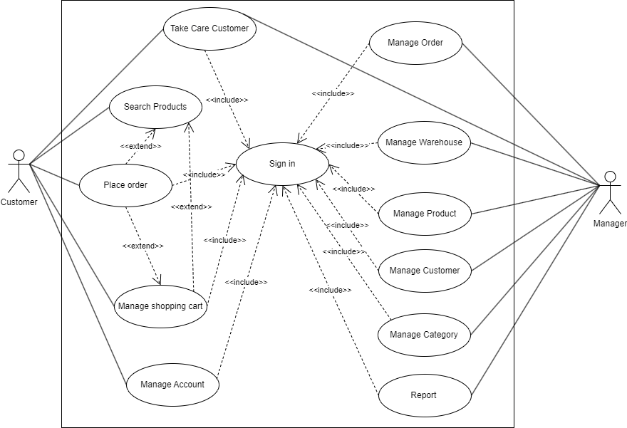
General Use case Diagram

Slide 5
2. Decomposition use case

Slide 6
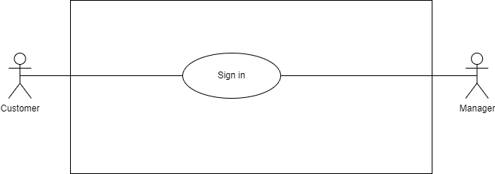
2.1 Use case of “Sign in”

Slide 7
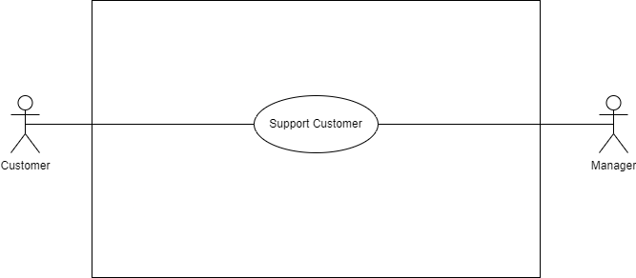
2.2 Use case of “Take Care Customer”

Slide 8
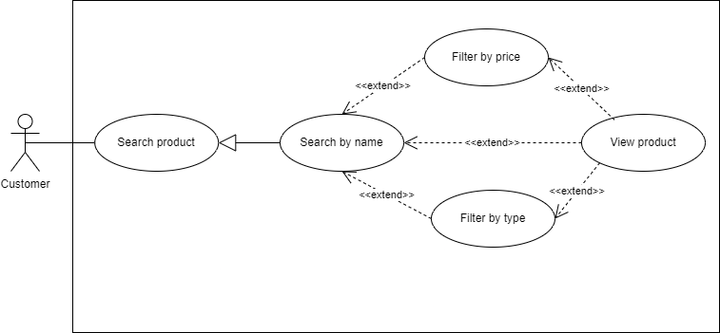
2.2 Use case of “Search Products”

Slide 9
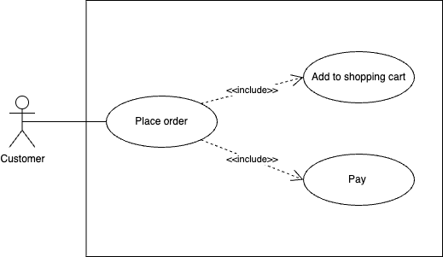
2.3 Use case of “Place Order”

Slide 10
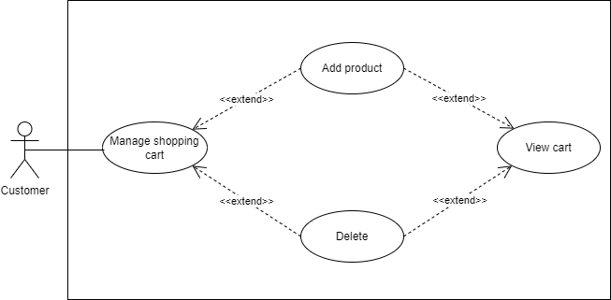
2.4 Use case of “Manage Shopping Cart”

Slide 11
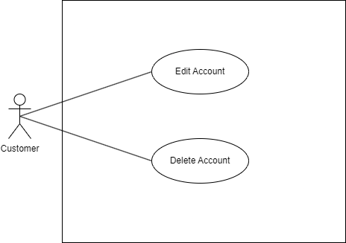
2.5 Use case of “Manage Account”

Slide 12
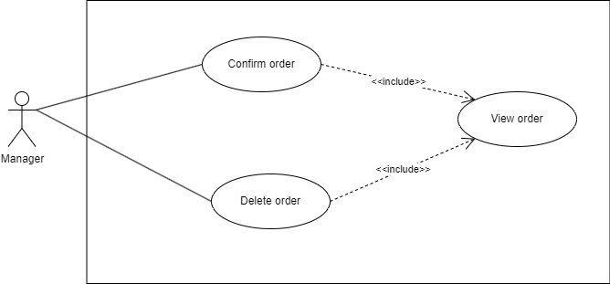
2.6 Use case of “Manage Order”

Slide 13
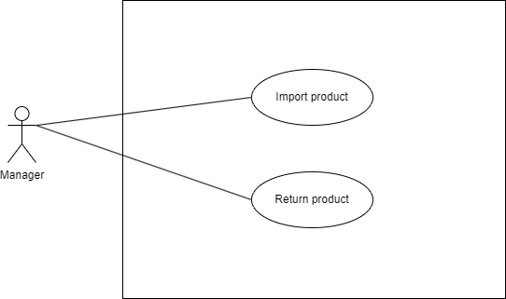
2.7 Use case of “Manage Warehouse”

Slide 14
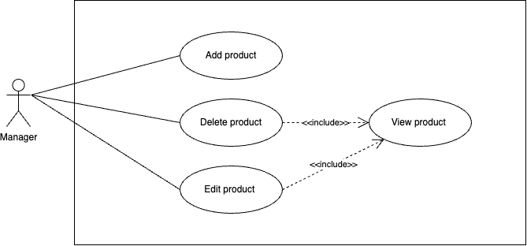
2.8 Use case of “Manage Product”

Slide 15
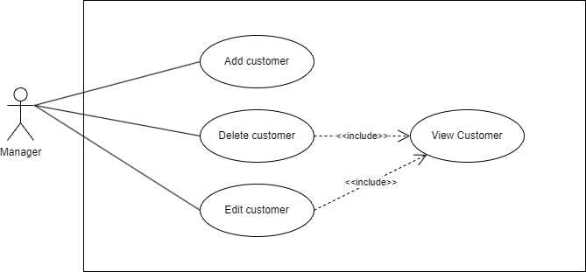
2.7 Use case of “Manage Customer”

Slide 16

2.8 Use case of “Manage Category”

Slide 17
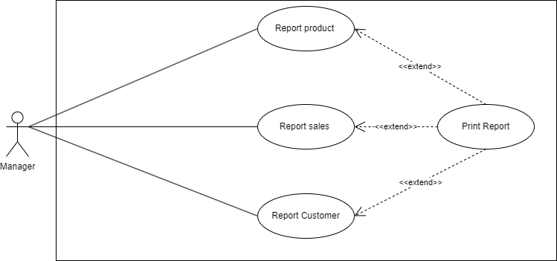
2.10 Use case of “Report”

Slide 18
Task 2:
Activity Diagram

Slide 19
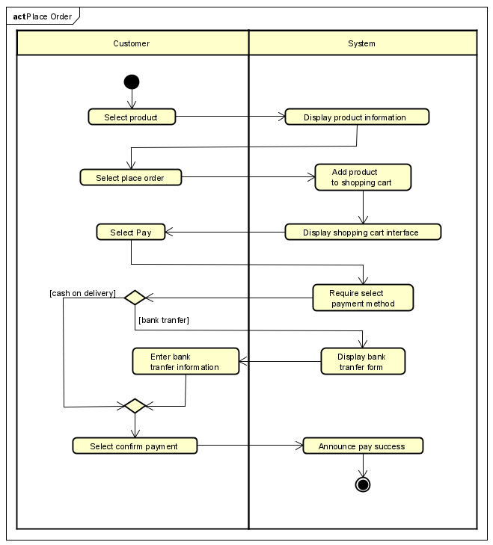
Activity Diagram of “Place Order”

Slide 20
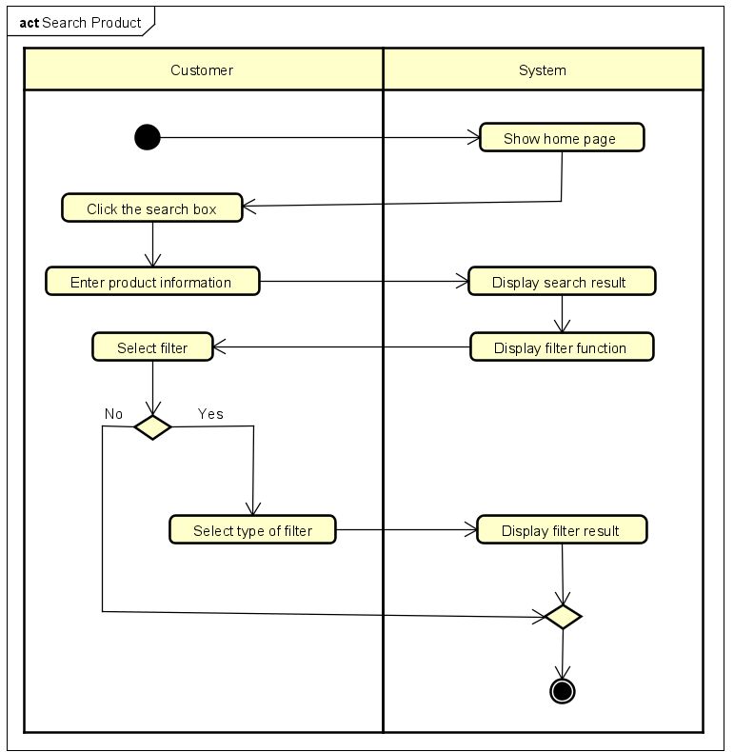
2. Activity Diagram of “Search Product”

Slide 21
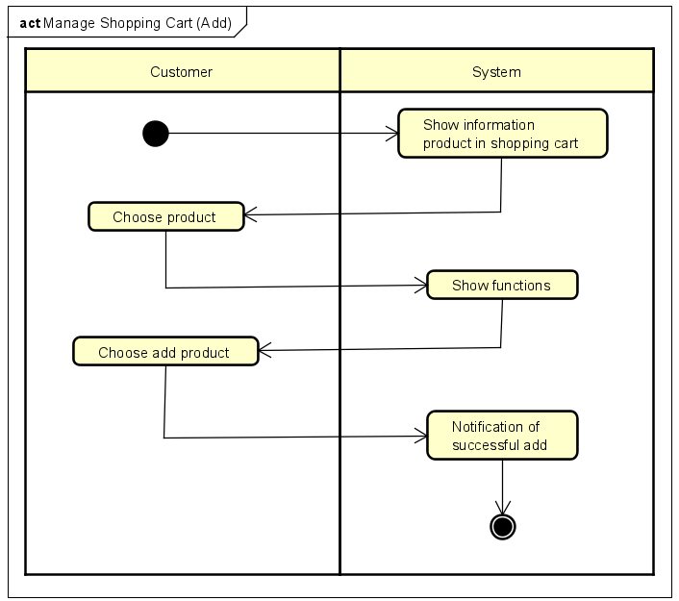
3.1 Activity Diagram of “Manage Shopping Cart (Add)”

Slide 22
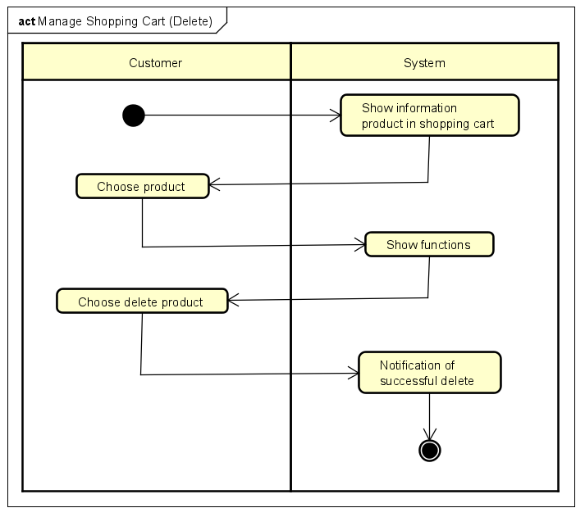
3.2 Activity Diagram of “Manage Shopping Cart (Delete)”

Slide 23
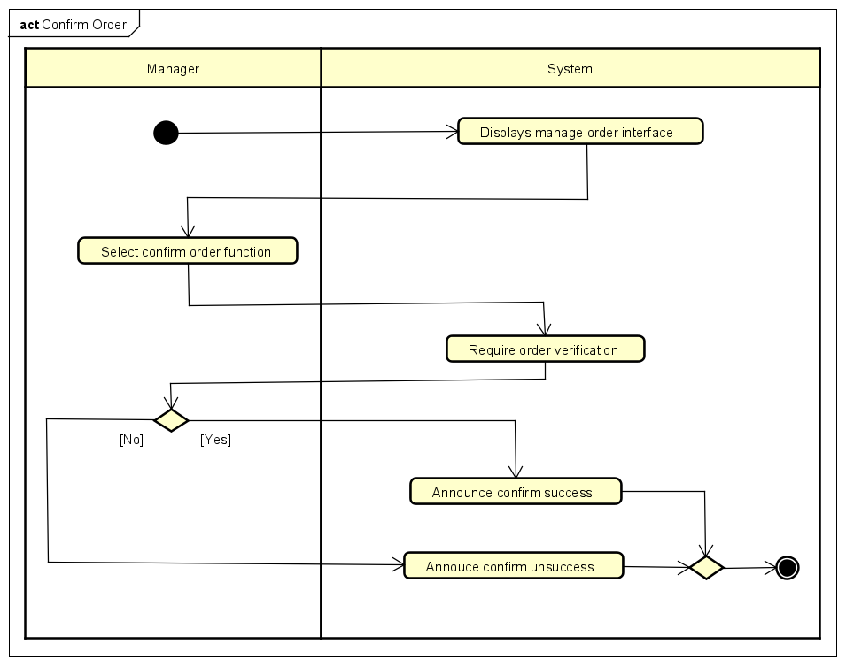
4.1 Activity Diagram of “Manage Order (Confirm)”

Slide 24
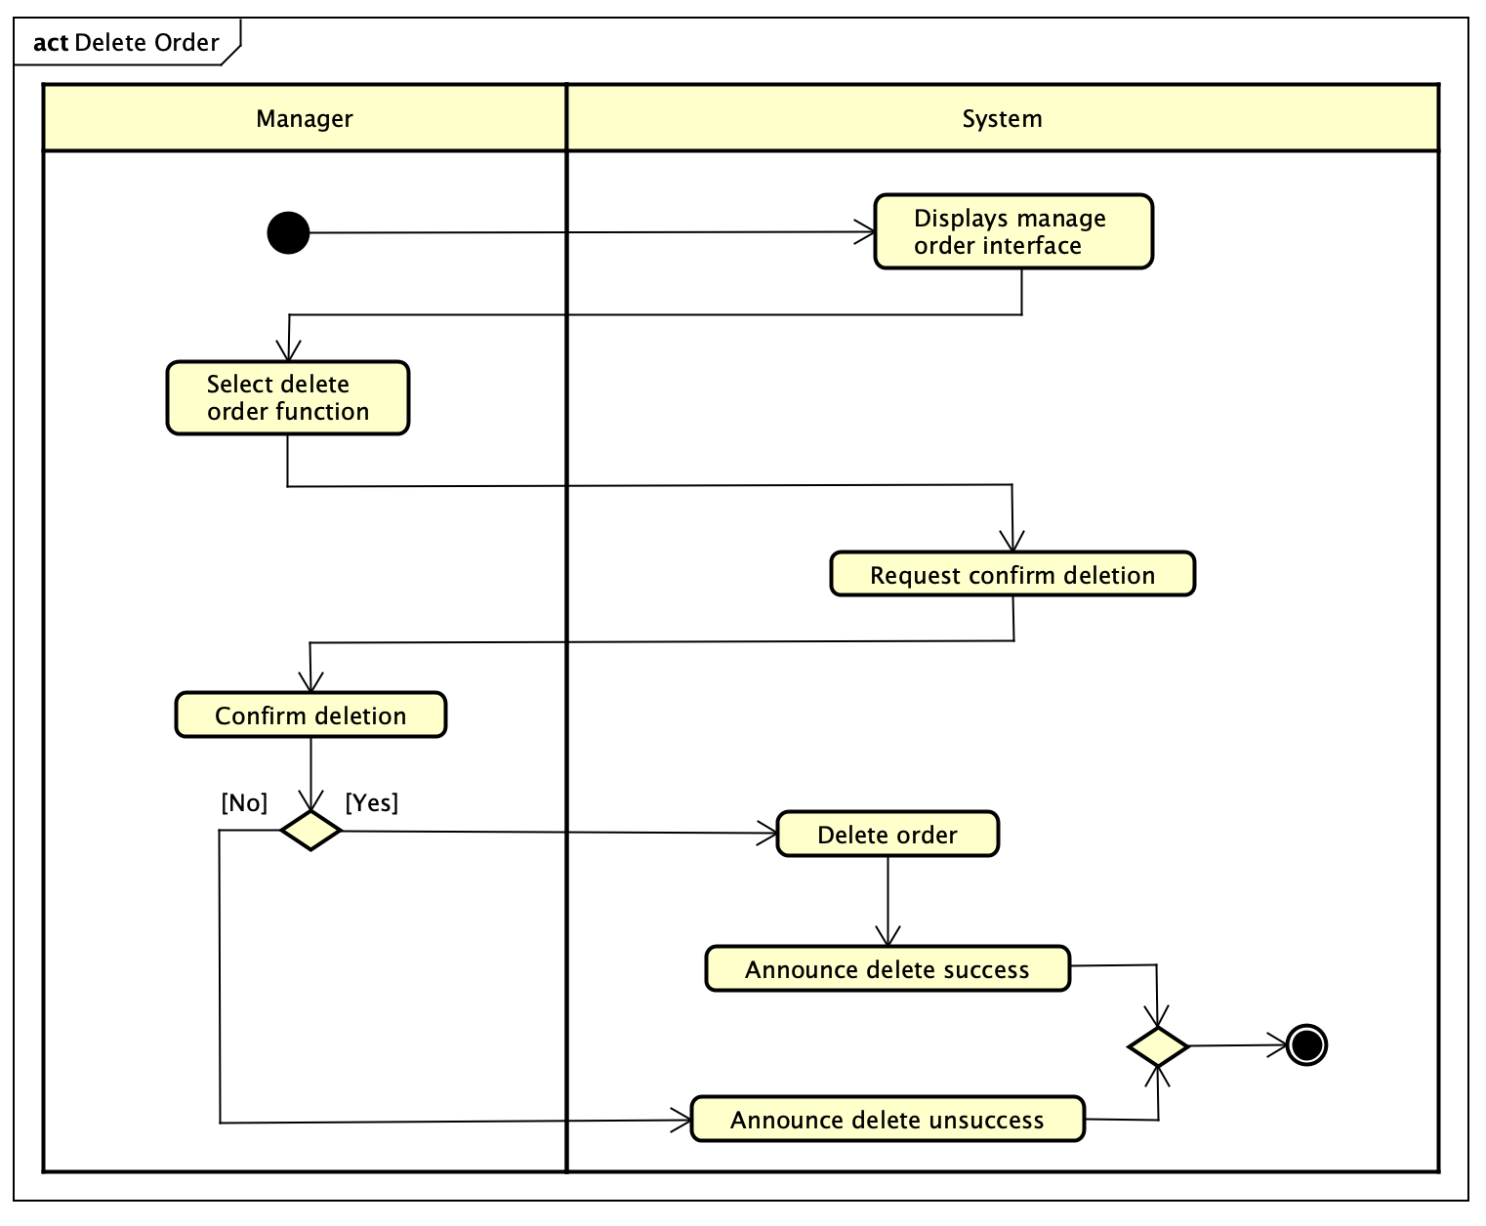
4.2 Activity Diagram of “Manage Order (Delete)”

Slide 25
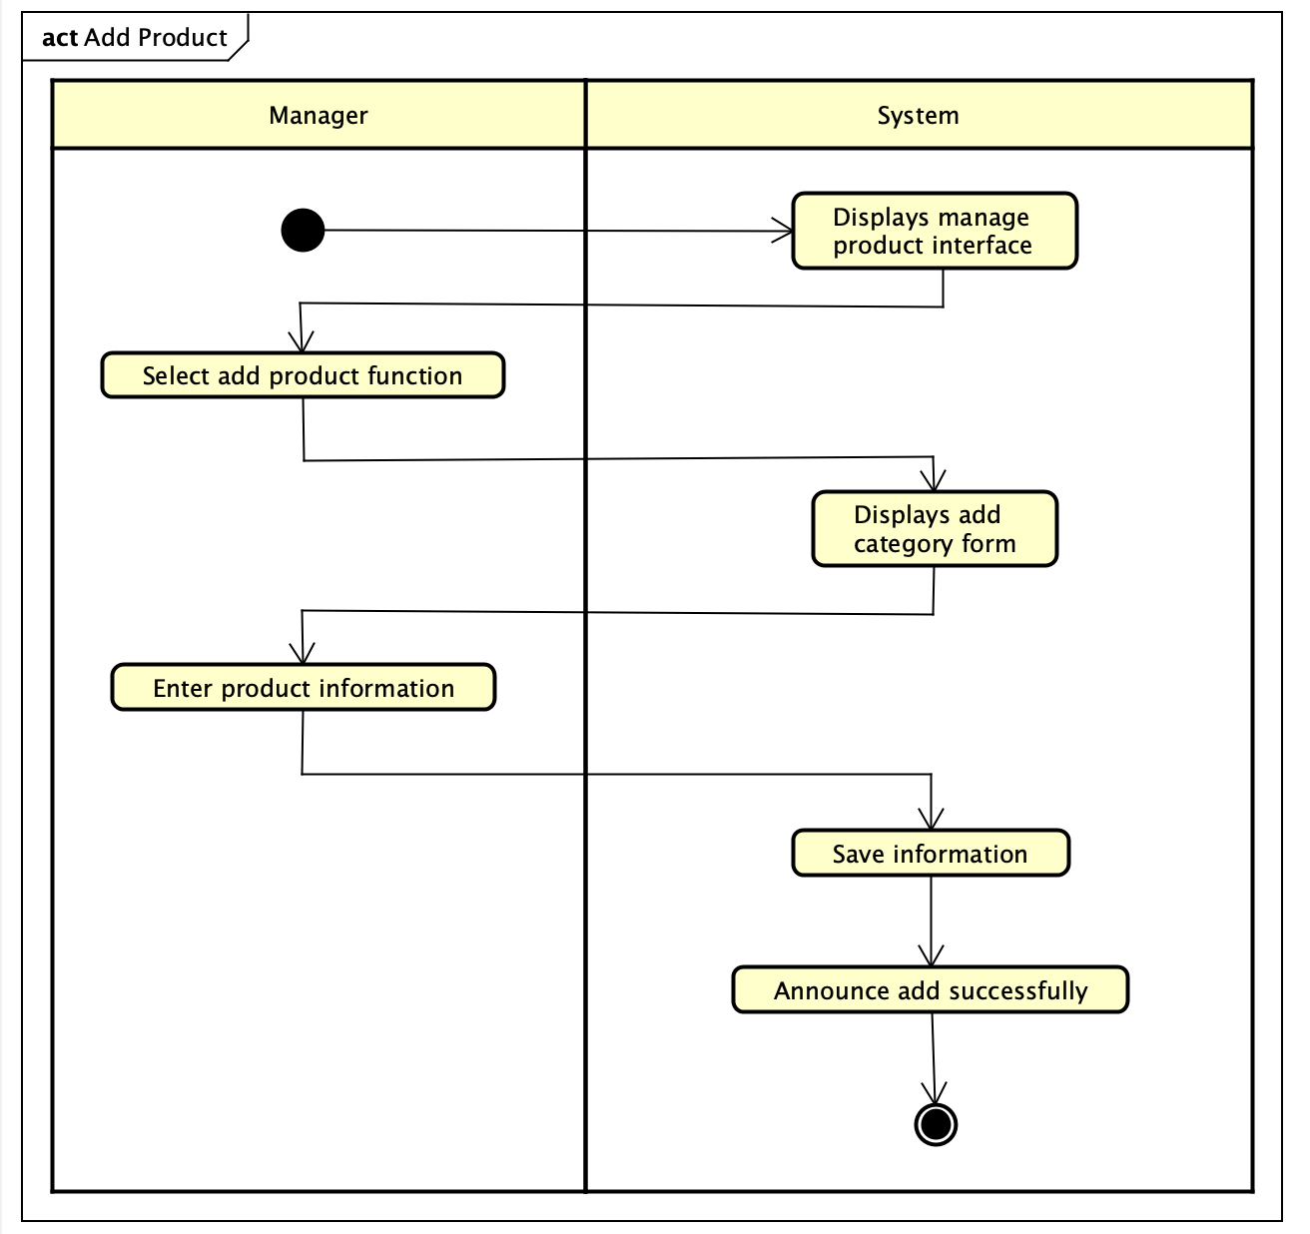
5. Activity Diagram of “Manage Product (Add)”

Slide 26
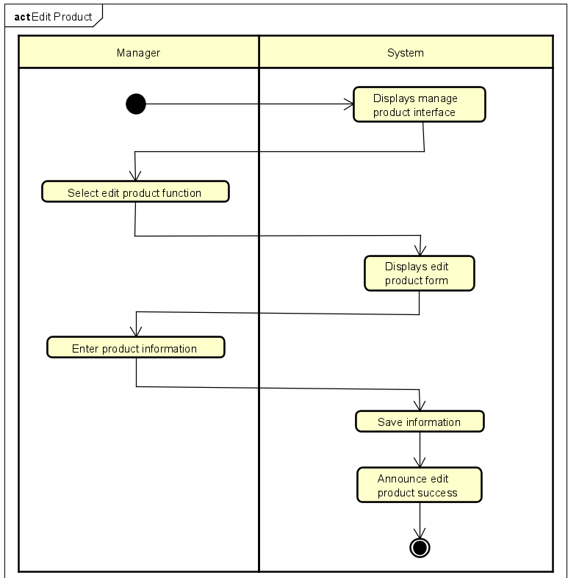
5. Activity Diagram of “Manage Product (Edit)”

Slide 27
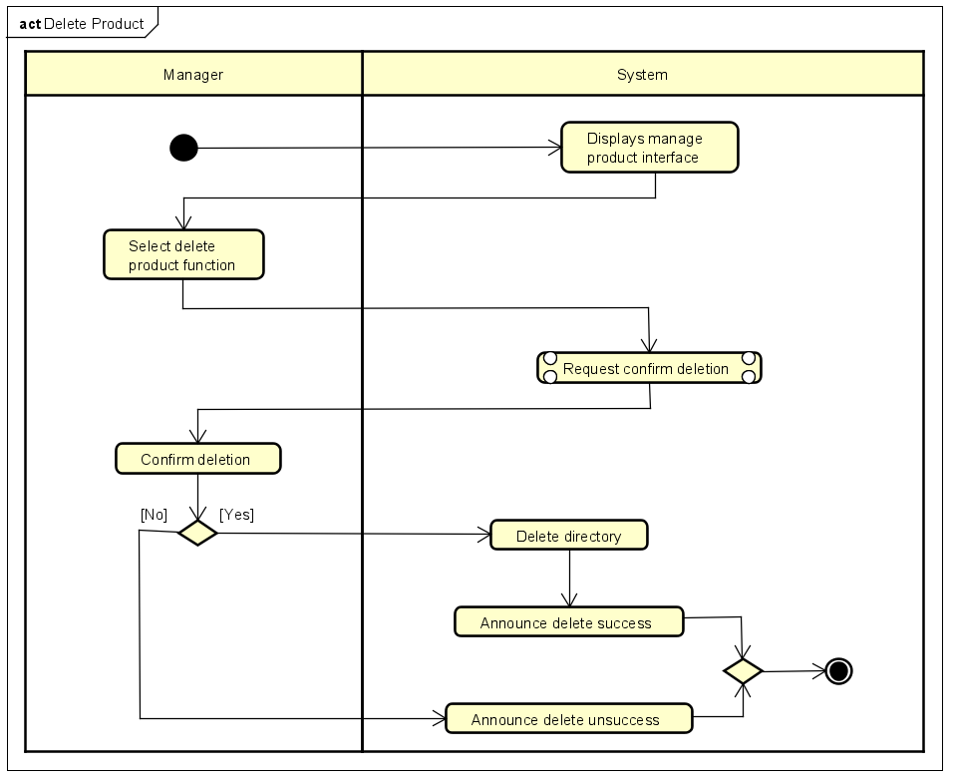
6. Activity Diagram of “Manage Product (Delete)”

Slide 28
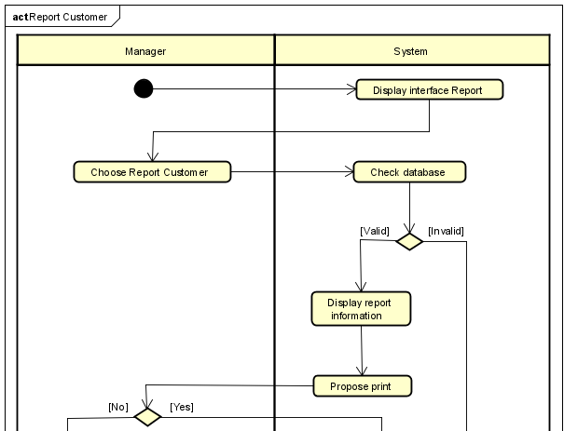
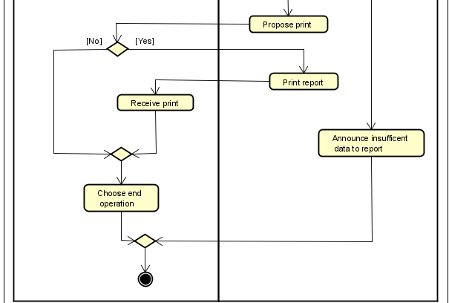
7. Activity Diagram of “Report (Customer)”

Slide 29
Task 3:
Sequence Diagram

Slide 30
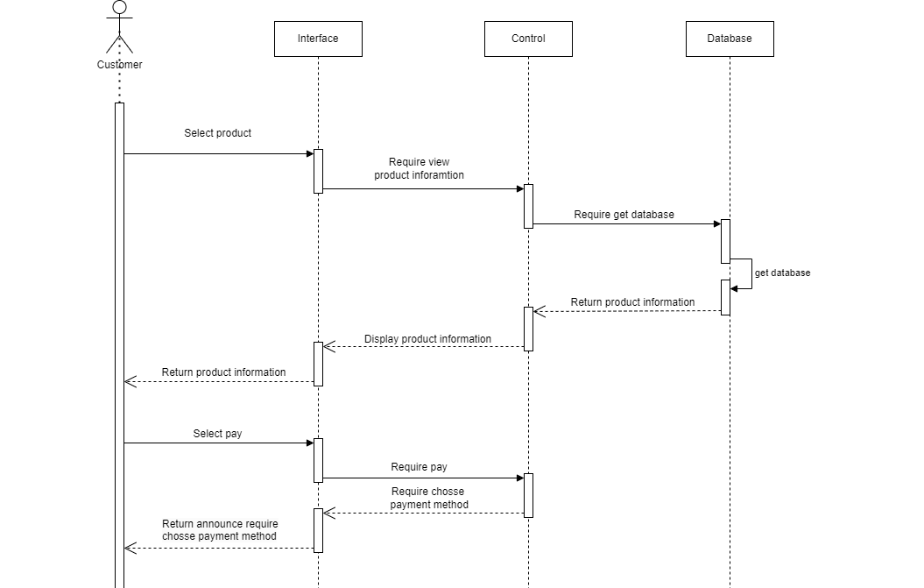
Sequence Diagram of “Place Order”

Slide 31
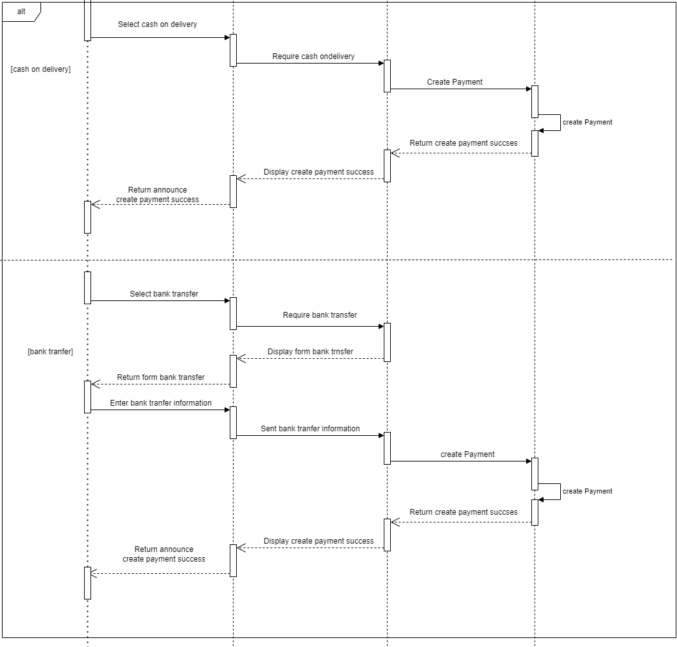
Sequence Diagram of “Place Order”

Slide 32
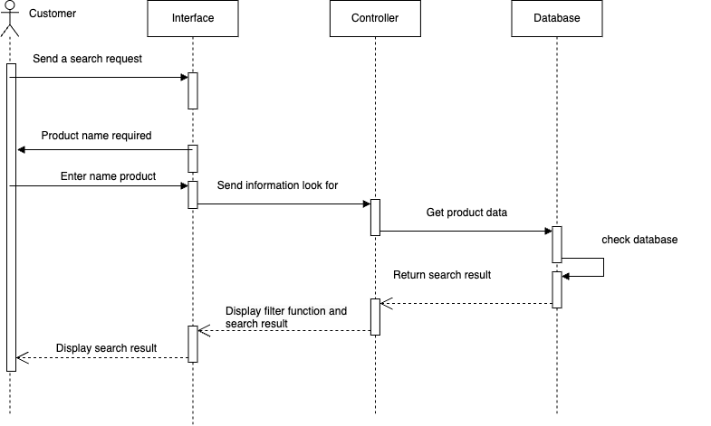
2. Sequence Diagram of “Search”

Slide 33
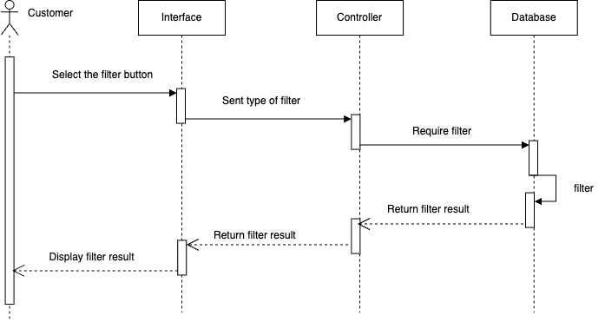
2. Sequence Diagram of “Search filter”

Slide 34
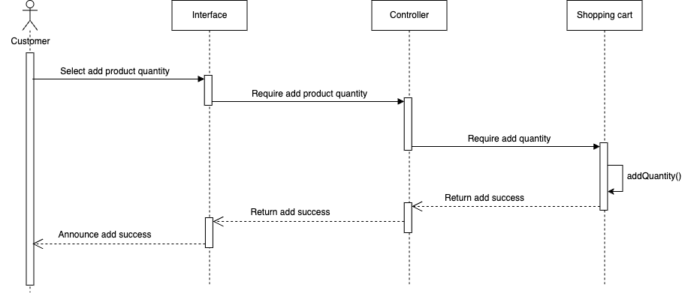
3.1 Sequence Diagram of “Manage Shopping Cart (Add)”

Slide 35
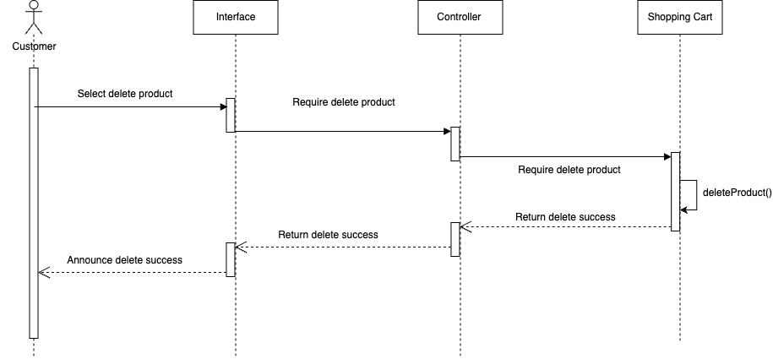
3.2 Sequence Diagram of “Manage Shopping Cart (Delete)”

Slide 36
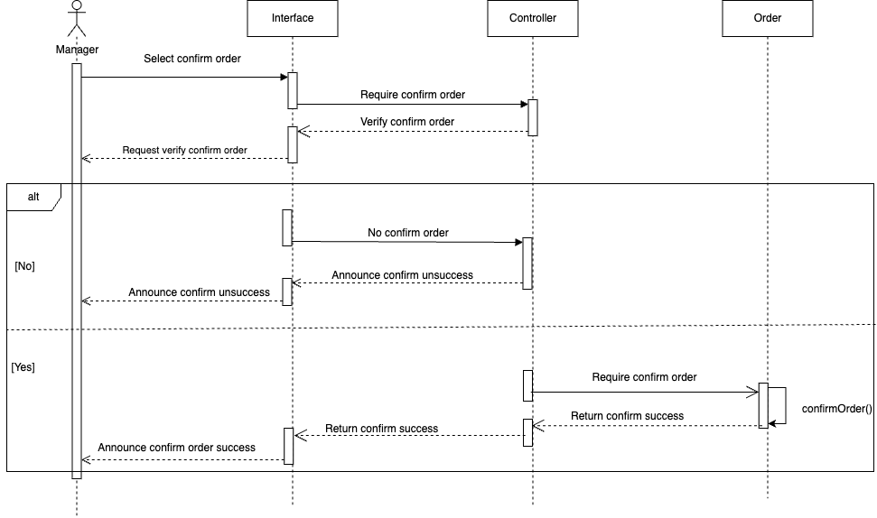
4.1 Sequence Diagram of “Manage Order (Confirm)”

Slide 37
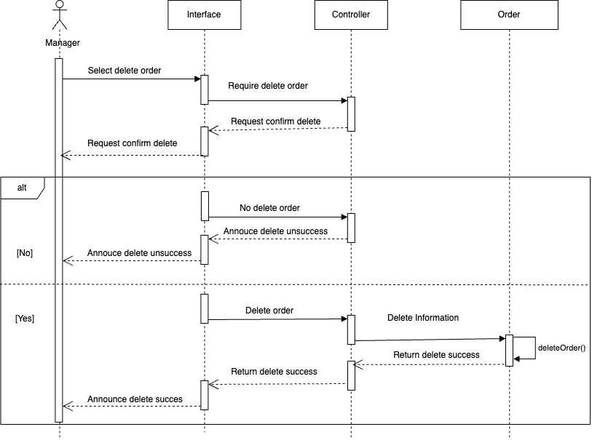
4.2 Sequence Diagram of “Manage Order (Delete)”

Slide 38
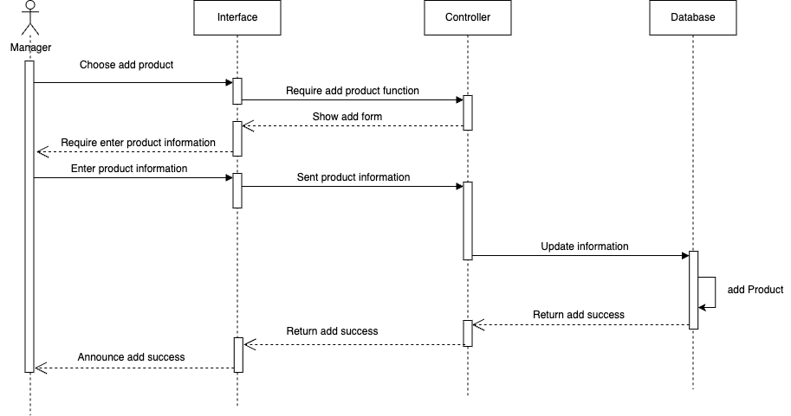
5.1 Sequence Diagram of “Manage Product (Add)”

Slide 39
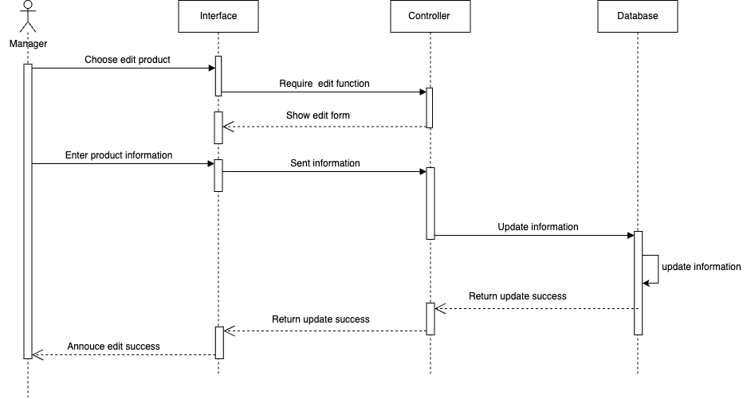
5.2 Sequence Diagram of “Manage Product (Edit)”

Slide 40
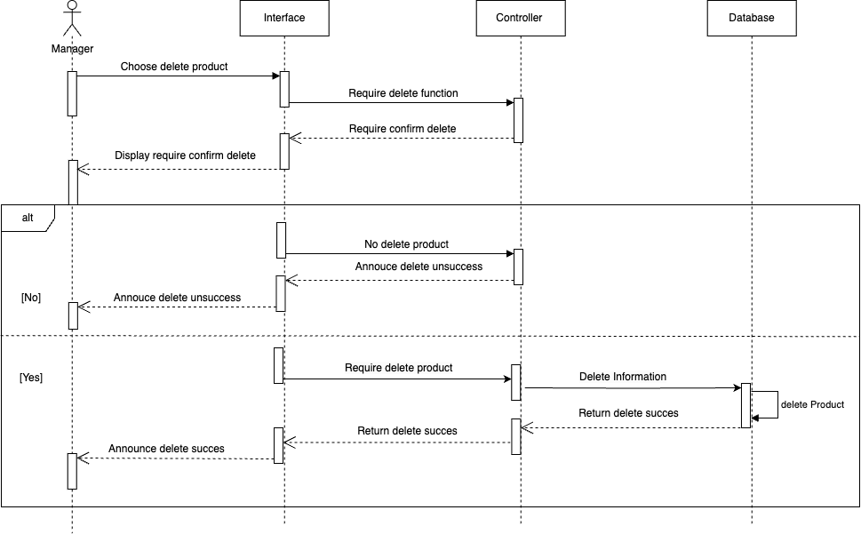
5.3 Sequence Diagram of “Manage Product (Delete)”

Slide 41
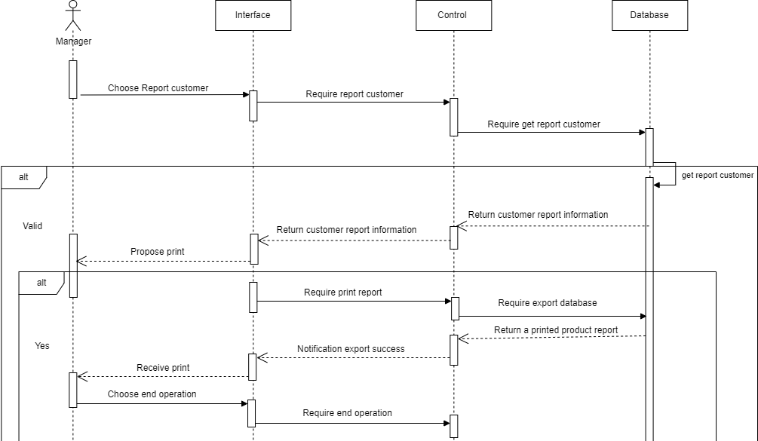
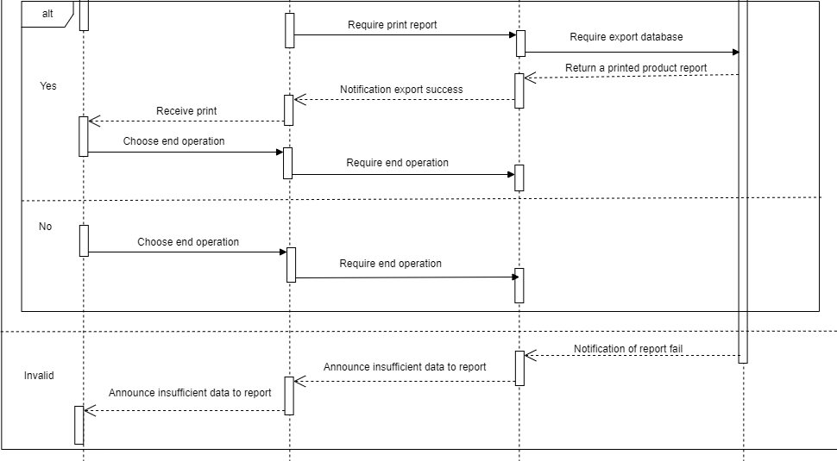
7. Sequence Diagram of “Report Customer”

Slide 42
Task 4:
Class Diagram

Slide 43
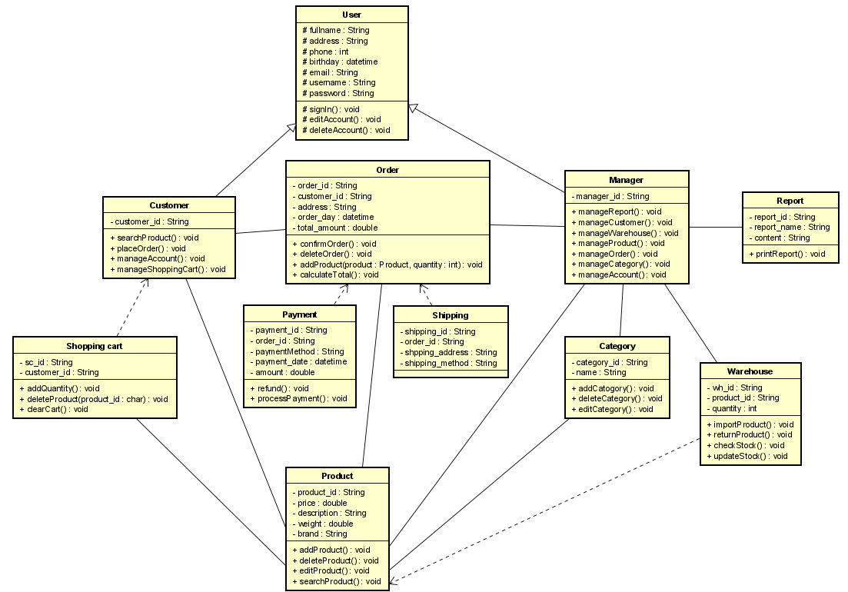
Class Diagram

Slide 44
Task 5:
Database model

Slide 45
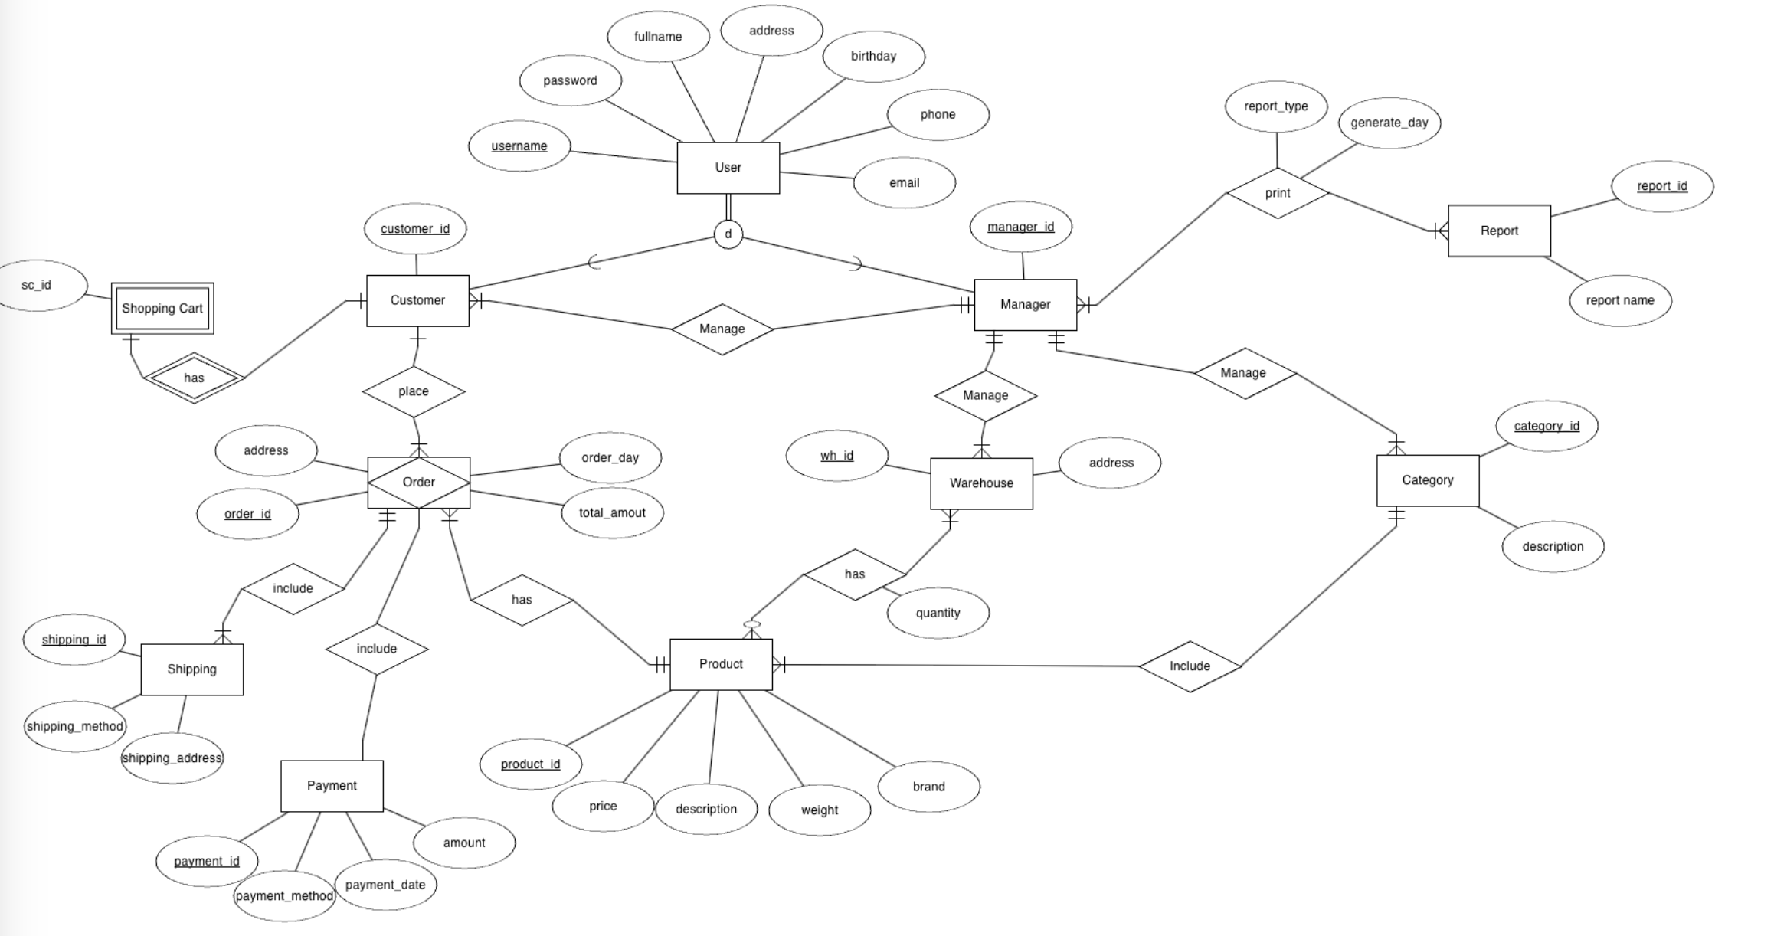
ERD

Slide 46
THANKS YOU
FOR LISTENING ❤️

